Slide 1
Project 3: Measuring Stellar Element Abundance
M. Berger, A. Bernhardt, M. Bleich, Y. Shi, A. Tarrant

Slide 2
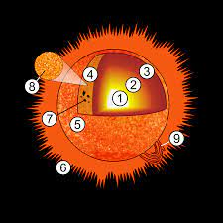
Measuring Elemental Abundance in Stars
One of the main applications of stellar spectroscopy
Strength of absorption lines provide information on the abundances of elements in the photosphere of the selected star
If we know the star's elemental abundance, we can get a good idea of the surrounding planet abundances

Slide 3
Goals
Understand the curve of growth method
Understand how stellar abundance is measured in the real world
Understand the Boltzmann & Saha equations and how they apply to measuring elemental abundance
Measure the elemental abundance of Na in the sun's photosphere relative to H
Report results in terms that physicists and astronomers can understand

Slide 4
Methods – Curve of Growth Method
Measure the equivalent width (EW) of one of the Na doublet lines
Find the Number density of Na atoms in the ground state from the Curve of Growth plot
Use the Boltzmann Eq. to estimate the ground state to excited state Na-atom ratio
Use the Saha Eq. to estimate the neutral to ionized Na-atom ratio
Compute the total column density of Na atoms in the sun's photosphere from the results of steps 2-4

Slide 5
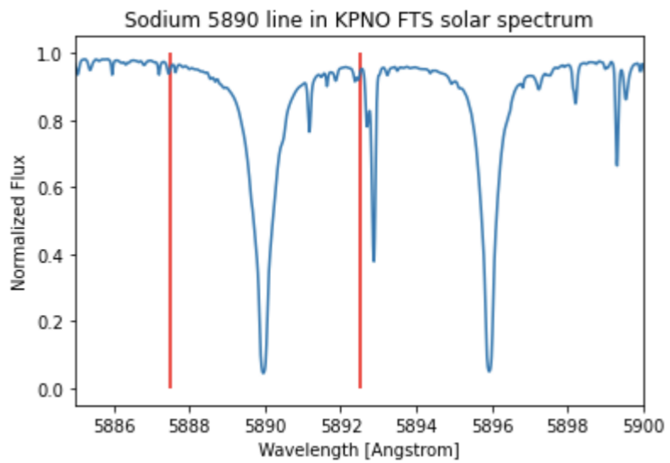
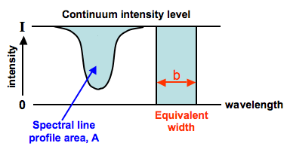
Methods – Equivalent width (EW)
EW – Width of a rectangle that produces an area that equals the spectral line profile area
At 𝜆 = 5890 Å, EW = 0.834672 Å

Slide 6
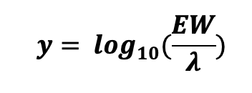
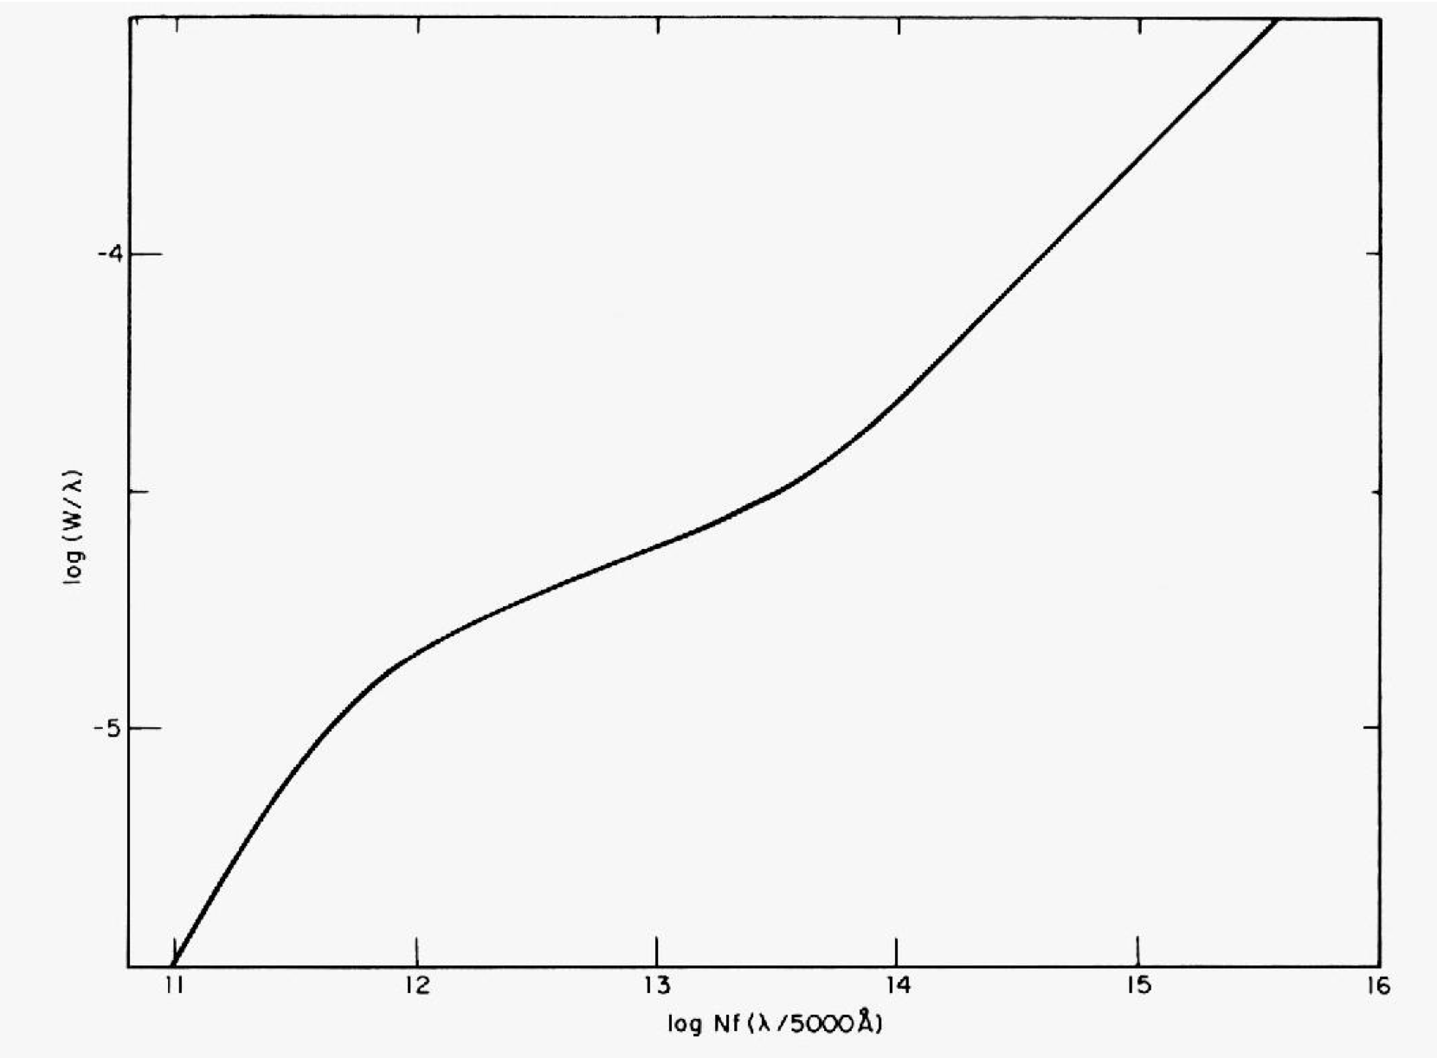

Methods – Curve of Growth (CG) Plot
Find the y-value on the CG plot by using:
- y = -3.85
Find the corresponding x-value by using the CG plot
- x ~ 14.8
Convert x to N by using:
- Oscillator strength: f = 0.65
N - Sodium GS Number Density

Slide 7

Methods - Boltzmann equation
N₂/N₁ is the ratio of excited state to ground state atoms
k = 1.38e-23 m² kg s⁻² K⁻¹ (Boltzmann constant)
g is the degree of degeneracy at each state
• g₂ = 6; g₁ = 2
E is the energy at each state
• E₂ = 2.105 eV; E₁ = 0 eV
T = T☉ = 5800 K

Slide 8
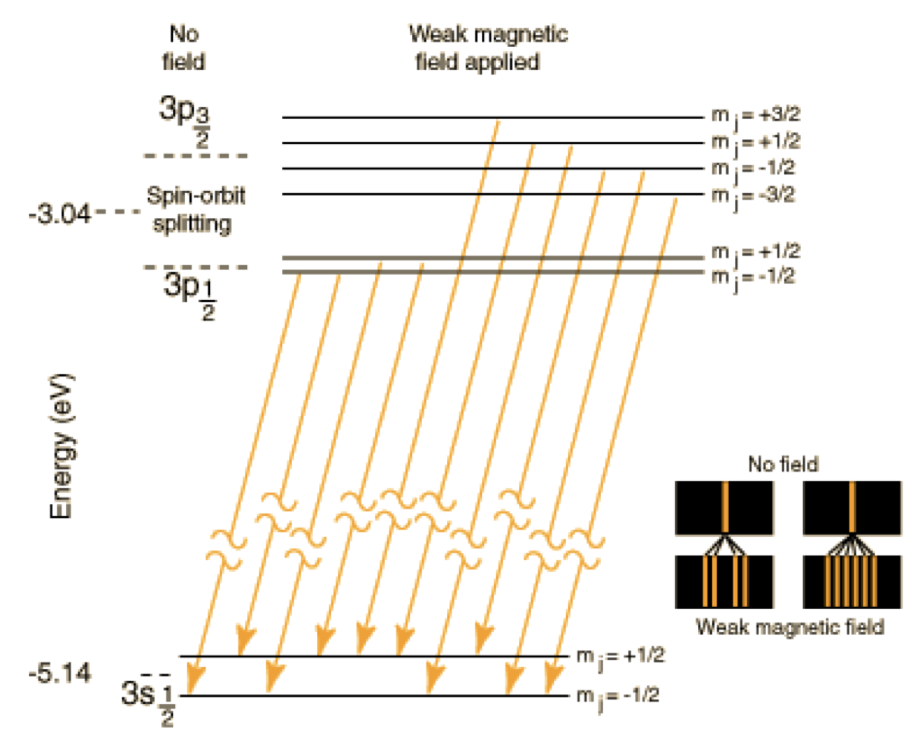


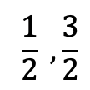
Finding the degree of degeneracy at each state
The degree of degeneracy describes the number of different states of equal energy
defines the degeneracy of the ground state (3s)
J = ½ (Spin)
defines the degeneracy of the excited state (3p)
J = (Spin)
Spin-Orbit coupling can be seen in the excited state

Slide 9

Methods - Saha equation
Na_{II}/Na_{I} is the ratio of ionized sodium atoms to neutral sodium atoms
k is Boltzmann constant; T = T☉
P_{e} is electron pressure from Ideal Gas Law
• P_{e} = 1.0 N m-2
Z is the partition function
• Z_{II} = 1.0; Z_{I} = 2.4
M_{e} = 9.109 e-31 kg (electron mass)
h = 6.626 e-34 J s (Planck constant)
χ = 5.1 eV (ionization energy)

Slide 10
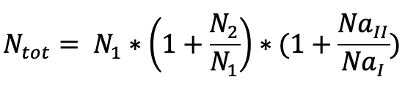
Methods – Total column density of Na
Use the results from the CG plot, Boltzmann eq., & Saha eq. to find the total column density of sodium atoms in the sun's photosphere

Slide 11
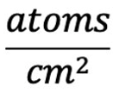
Methods – Abundance of Na relative to H in Physicist's terminology
NH = 6.6 x 10²³
NNa = Ntot
Elemental Abundance = N_{Na}/N_{H}
Mole Ratio!

Slide 12

Methods – Abundance of Na relative to H in Astronomer's terminology
NH = 6.6 x 10²³
NNa = N_{tot}
Elemental Abundance = 12 + log₁₀ (N_{Na}/N_{H})
Note: 12 is the elemental abundance in the solar photosphere of hydrogen (Lodders et al., 2009).

Slide 13
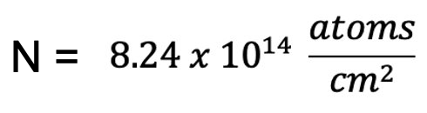
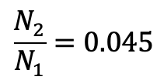
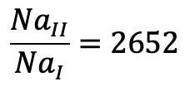
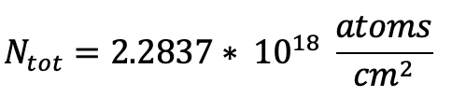
Results
From the curve of growth model, N is:
From the Boltzmann equation, the ratio N2/N1 is:
From the Saha equation, the ratio Na_{II}/Na_{I} is:
The total column density is N_{total} is:

Slide 14

Results (cont.)
Physicist abundance = 3.45 x 10⁻⁶
Astronomer's abundance = 6.54
- [Na/H] = 0.264

Slide 15
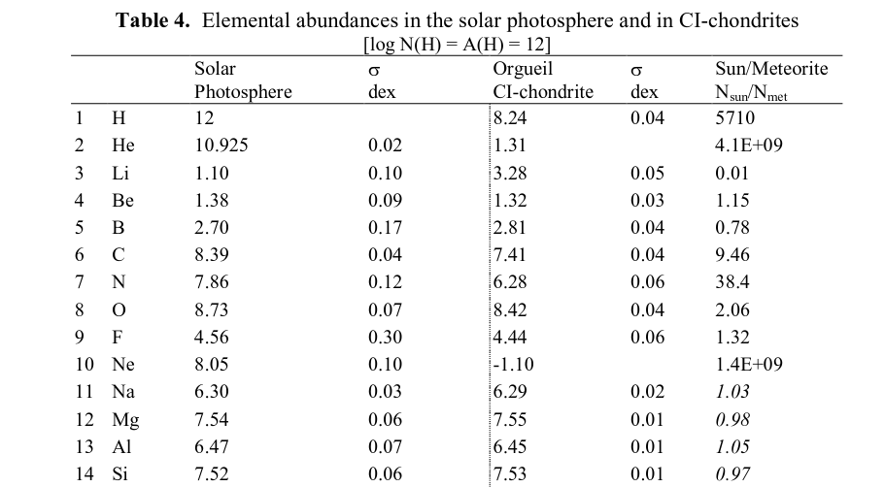
Are these results valid?
Calculated elemental abundance = 6.54
Na value should be around 6.30, so we are very close to the true value
Potentially due to the chosen temperature constant
Modified from Lodders et al., 2009

Slide 16
Conclusions
For every mole of Na, there will be ~ 2.9 x 10^5 moles of H
Used temp. constant may have led to the elemental abundance being slightly greater than the tabulated value

Slide 17
Contributions
Alex – Boltzmann Eq, slides, abundance calculations
Ashley – Saha Eq, slides, written report
Mariana – Boltzmann Eq, slides, abundance calculations
Missie – Saha Eq, slides
Yuanhao – Calculations

Slide 18
References
Lodders, K., Palme, H., & Gail, H. P. (2009). Abundances of the elements in the solar system. arXiv preprint arXiv:0901.1149.
Sadek, R., Kassem, M., Abdo, M., & Elbasuney, S. (2017). Novel yellow colored flame compositions with superior spectral performance. Defence Technology, 13(1), 33-39.
https://www.chem.uci.edu/~unicorn/old/H2A/handouts/PDFs/sodium.pdf

